Slide 1
Ride-Sharing Application Using Graphs And Dijkstra's Algorithm
DSA BOOTCAMP -2024
Computer Engineering & Information Technology
Student Name :
Vikash Kumar (2248413)
Youraj Kumar (2248412)
Vishwajeet Kumar(2246039)
Wasim Khan (2246079)
Yuvraj Kumar Yadav (2247270)
Submitted To:
Deepti Ma’am
(Bootcamp Trainer)

Slide 2
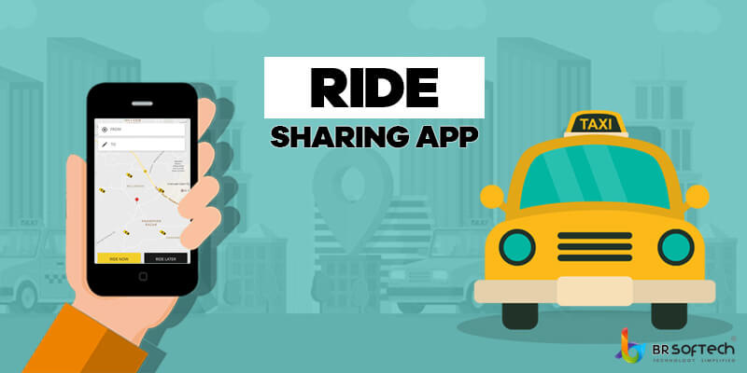
Introduction to Ride-Sharing Applications
Ride-sharing applications connect passengers with drivers through a mobile platform.
These applications have transformed urban transportation by providing convenient alternatives to traditional taxis.
Understanding the underlying algorithms helps improve efficiency and user experience in these apps.
Notes:
Image source: http://mrpassenger.com/safety-tips-when-using-ride-sharing-apps-abroad/

Slide 3
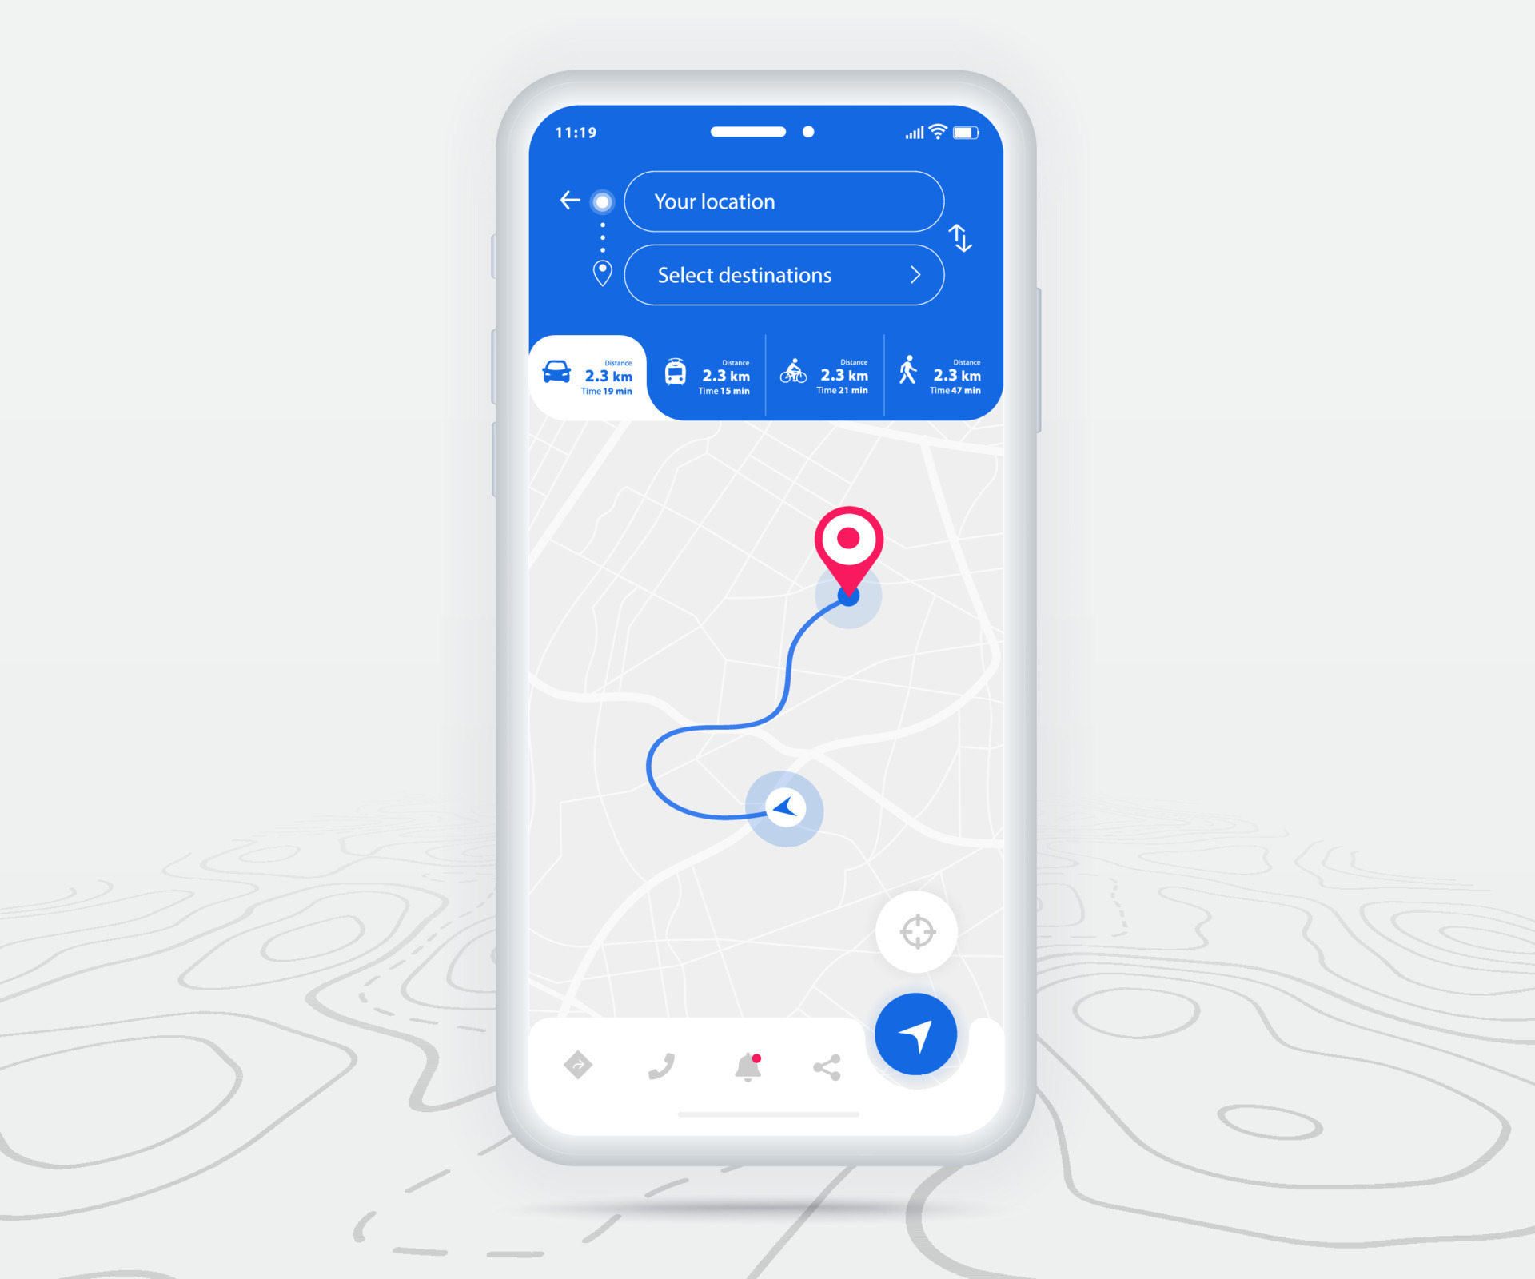
OBJECTIVES
Main Objective:
To implement Dijkstra's algorithm to find the shortest
possible path between two locations on a map.
Specific Goals:
Enhance user experience by reducing travel time.
Minimize fuel consumption and operational costs.
Provide time taken, route and Distance.
Notes:
Image source: https://www.yumpu.com/en/document/view/24719987/graph-theory

Slide 4
Programming Language: Python
Libraries Used:
networkx: For creating and manipulating complex graphs.
matplotlib.pyplot: For plotting graphs and visualizations.
heapq: For implementing priority queues in Dijkstra's algorithm.
datetime: For handling date and time operations.
IDE:
Vs code
Technology stack
Notes:
Image source: https://www.slideteam.net/real-time-data-integration-ppt-powerpoint-presentation-icon-maker-cpb.html

Slide 5
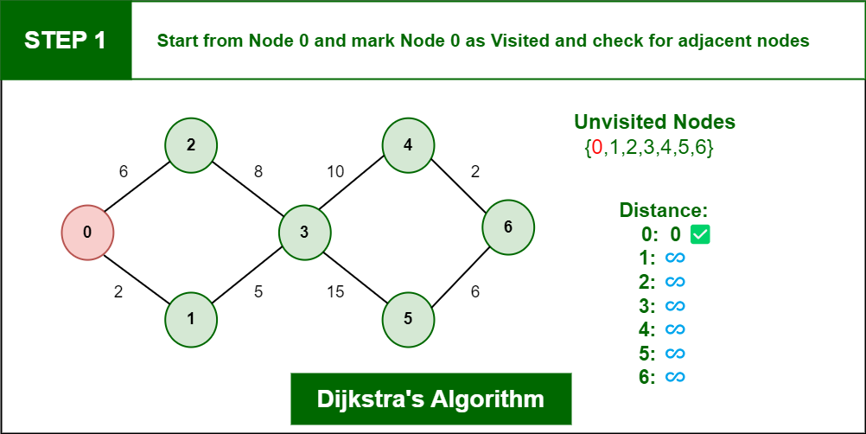
What is Dijkstra's Algorithm?
Dijkstra's Algorithm is a popular graph search algorithm used to find the shortest path between nodes.
It operates by iteratively selecting the nearest unvisited node and updating the shortest path to its neighbors.
This algorithm is particularly useful in ride-sharing applications to minimize travel time for drivers and passengers.
Notes:
Image source: https://www.geeksforgeeks.org/introduction-to-dijkstras-shortest-path-algorithm/

Slide 6
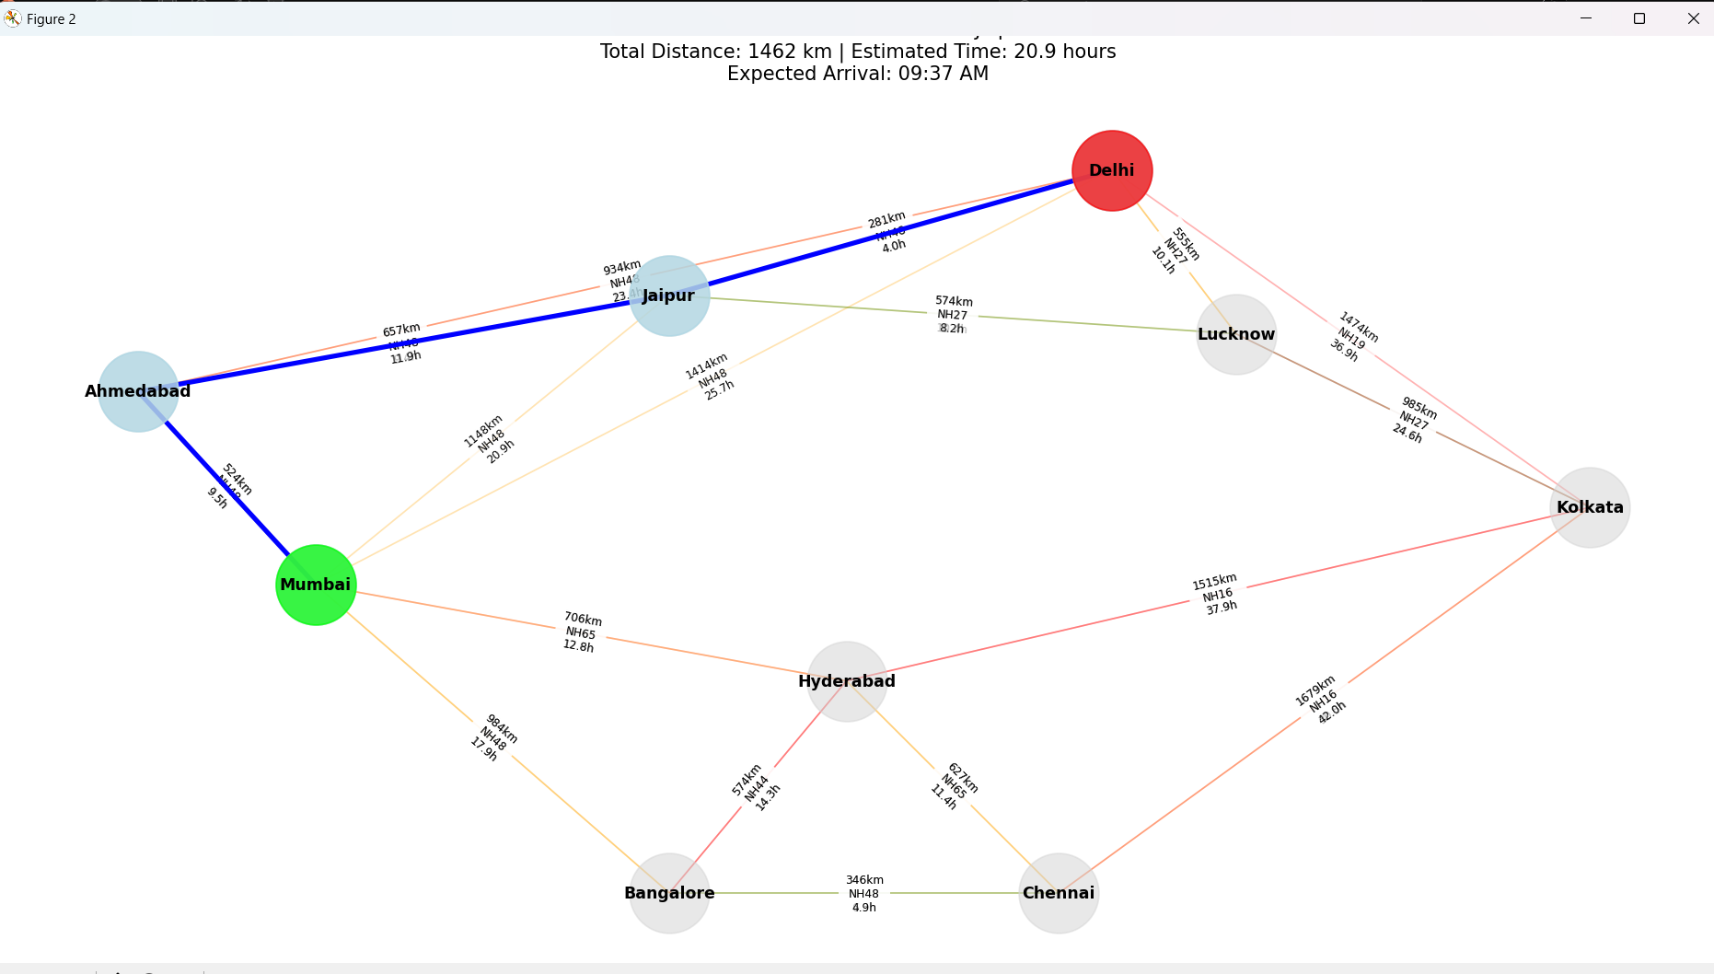
Implementing Dijkstra's Algorithm
To implement Dijkstra's Algorithm, we first initialize the distance from the starting node to zero.
The algorithm systematically explores all connected nodes, updating the shortest known distance.
The final result is a map of the shortest paths from the starting location to all other nodes in the graph.
Notes:
Image source: https://iramlee.medium.com/implementing-dijkstras-algorithm-from-scratch-3b659b6f3383

Slide 7
FLOW OF CODE
Pathfinding: Uses Dijkstra's algorithm to find the best route between two cities while considering traffic conditions.
Visualization: Provides a visual representation of the route with real-time information, including color-coded traffic conditions.
User Interaction: Prompts users for input to determine ride details and uses the graph to generate information about their journey.
Graph Creation: Defines a network of cities with distances and metadata (traffic, route).
Notes:
Image source: https://www.youtube.com/watch?v=LDCa4U-ZbJ0

Slide 8
Methods Used
Graph Algorithms: Dijkstra's algorithm is employed to find the shortest path in a weighted graph considering dynamic weights based on traffic.
Data Structures: Uses dictionaries for graph representation and priority queues for efficient pathfinding.
Visualization Techniques: Utilizes plotting functions from Matplotlib to create informative visual representations of the route data.
Notes:
Image source: https://www.youtube.com/watch?v=LDCa4U-ZbJ0

Slide 9
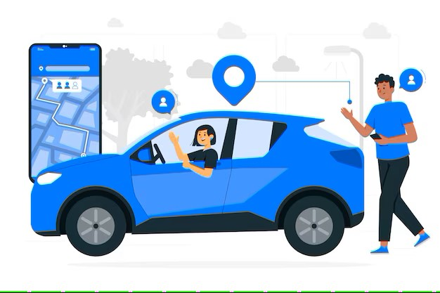
Industrial Applications
Ride-sharing services for optimized routing.
Logistics companies for efficient delivery planning.
Travel agencies for customized itineraries.
Urban planning departments for traffic management.
Notes:
Image source: https://datasciencedojo.com/blog/ai-and-machine-learning-trends/

Slide 10
Future Directions
Explore Additional Algorithms: Investigate the A* algorithm for enhanced efficiency using heuristics in pathfinding.
Integrate Real-Time Traffic Data: Incorporate live traffic updates to optimize routes based on current conditions.
Analyze User Behavior: Implement machine learning to predict demand and optimize ride-sharing strategies.
Enhance User Interface: Develop an interactive UI for visualizing routes and providing real-time updates.
Optimize Scalability: Improve algorithm efficiency and utilize parallel processing for better performance under high user loads.
Notes:
Image source: https://datasciencedojo.com/blog/ai-and-machine-learning-trends/

Slide 11
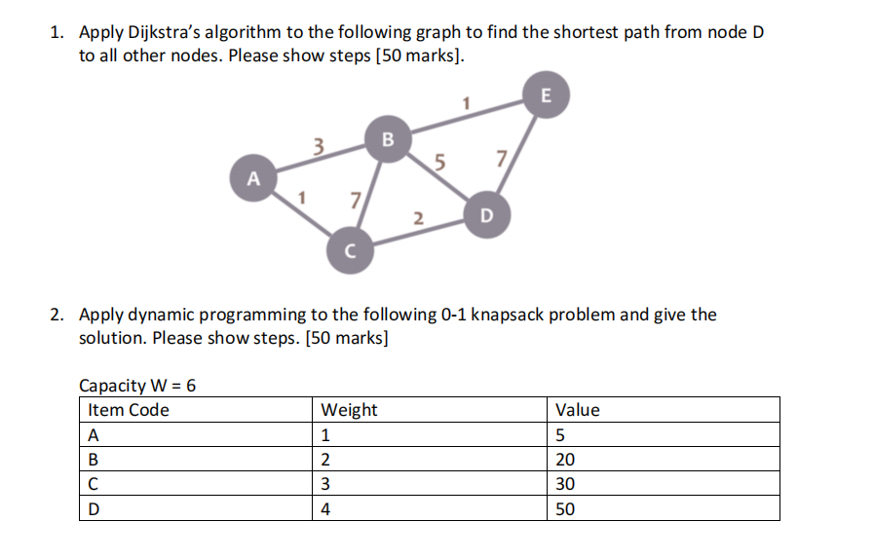
Conclusion
The application of graphs and Dijkstra's Algorithm significantly enhances ride-sharing applications.
These technologies allow for efficient routing, improved user experiences, and reduced operational costs.
Continued research and development in this area will shape the future of urban transportation.
Notes:
Image source: https://mavink.com/explore/Dijkstra-Flowchart

Slide 12
Thank You☺
Notes:
Image source: https://datasciencedojo.com/blog/ai-and-machine-learning-trends/

